Slide 1
Automated Prediction of Non Alcoholic Fatty Liver Disease using Machine Learning Algorithms

Slide 2
Abstract
The prevalence of obesity has lead the metabolic syndrome Non-Alcoholic Fatty Liver Disease (NAFLD) to be a serious health concern over the years.
Early prediction on liver disease using classification algorithm is an efficacious task that can help the doctors to diagnose the disease within a short period of time.
The main objective of this project is to identify the potential factors causing NAFLD by using Naïve Bayes, Decision Tree classifier, Random Forest classifier algorithm.

Slide 3
INTRODUCTION
Non-Alcoholic Fatty Liver Disease or NAFLD is a common clinical complication, is associated with high morbidity and mortality.
A machine learning model has been using to predict liver disease that could assist physicians in classifying high-risk patients and make a novel diagnosis.

Slide 4
Problem Statement
Non-Alcoholic Fatty Liver Disease or NAFLD is a common and rising entity which leads to various liver disorders.
Its prevalence is increasing at a rapid rate due to the increasing levels of obesity, diabetic patients and hypertension.
These disorders are where the liver damage is unrelated to alcohol consumption.
We aimed to develop a machine learning model to predict NAFLD that could assist physicians in classifying high-risk patients and make a novel diagnosis, prevent and manage NAFLD.

Slide 5
EXISTING SYSTEM
In existing system electronic health records from the Optum Analytics to
(1) identify patients diagnosed with benign steatosis and NASH, and
(2) Train machine learning classifiers for NASH and healthy (non-NASH) populations to
(3) predict NASH disease status on patients diagnosed with NAFL.

Slide 6
PROPOSED SYSTEM
In this study, we are trying to develop and compare, the four classification models to predict fatty liver disease accurately. However, the random forest model showed higher performance than other classification models.
Implementation of a random forest model in the clinical setting could help physicians to stratify fatty liver patients for primary prevention, surveillance, early treatment, and management.
The performance of several methods including k-nearest neighbor, decision tree, random forest, and support vector machine will be compared in this work.
We observed that metabolic syndrome, body mass index, triglyceride, total cholesterol, age, waist to hip ratio, highdensity lipoprotein cholesterol, low-density lipoprotein cholesterol might be the risk factors of NAFLD and accuracy is compared for all algorithms.

Slide 7
Advantages
we preferred random forest & other three methods because it is straightforward to interpret. Furthermore, we are trying to investigate several machine learning methods, including k-nearest neighbor, decision tree, and support vector machine to predict the incidence of NAFLD.
Compared to the literature reviews whose accuracy falls in the interval of 60% and 75%, our models obviously perform better.

Slide 8
System Requirement
Html,Css, JavaScript
Anaconda prompt
python

Slide 9
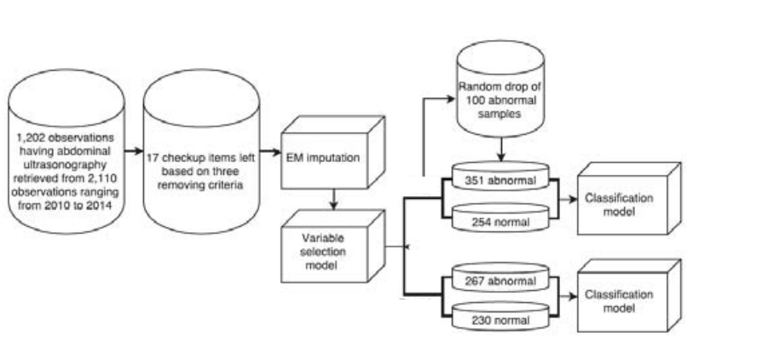
Architecture diagram (example):

Slide 10
CONCLUSION
The findings of this project show that machine learning classification models especially the random forest model accurately predicts a non-alcoholic fatty liver disease patient.
This project may help us to find out some undiscovered factors majorly causing NAFLD.
This method may lead to greater insights for doctors to effectively identify NAFLD for novel diagnosis, and for preventive and therapeutic purposes to mitigate the global burden of NAFLD.

Slide 11
Thank you
GUIDE: G MOUNICA
TEAM MEMBERS:
A N L GAYATHRI (17P31A0567)
K B SAI MANOHAR(17P31A0585)
SUNIL KUMAR SHA(17P31A0594)
P LAHARI PRIYA(17P31A05A1)

